Slide 1

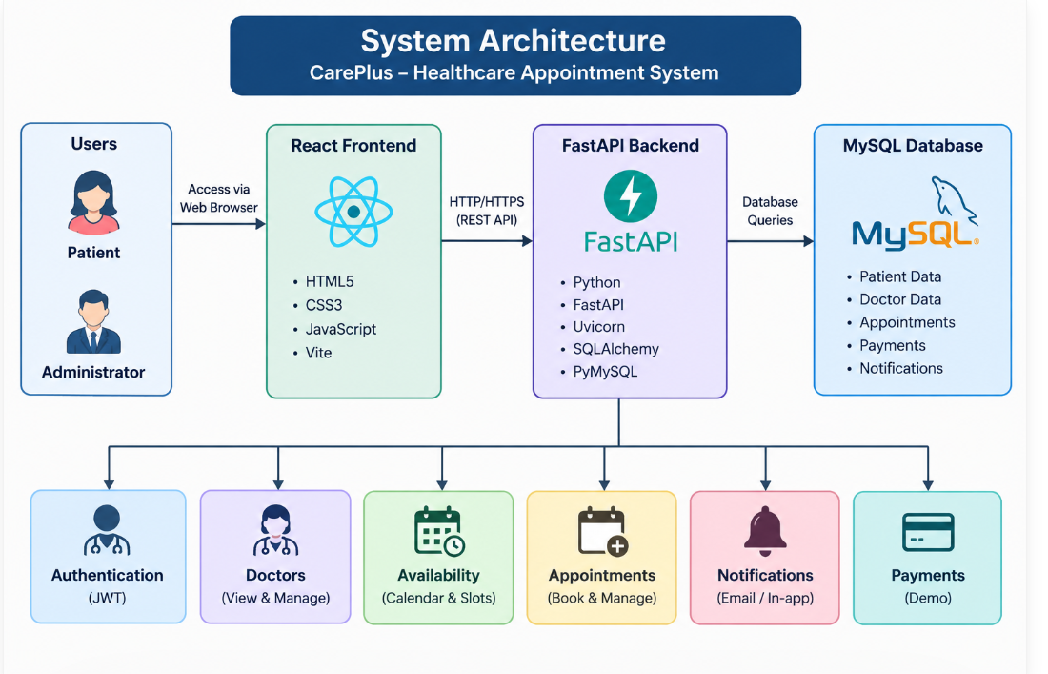
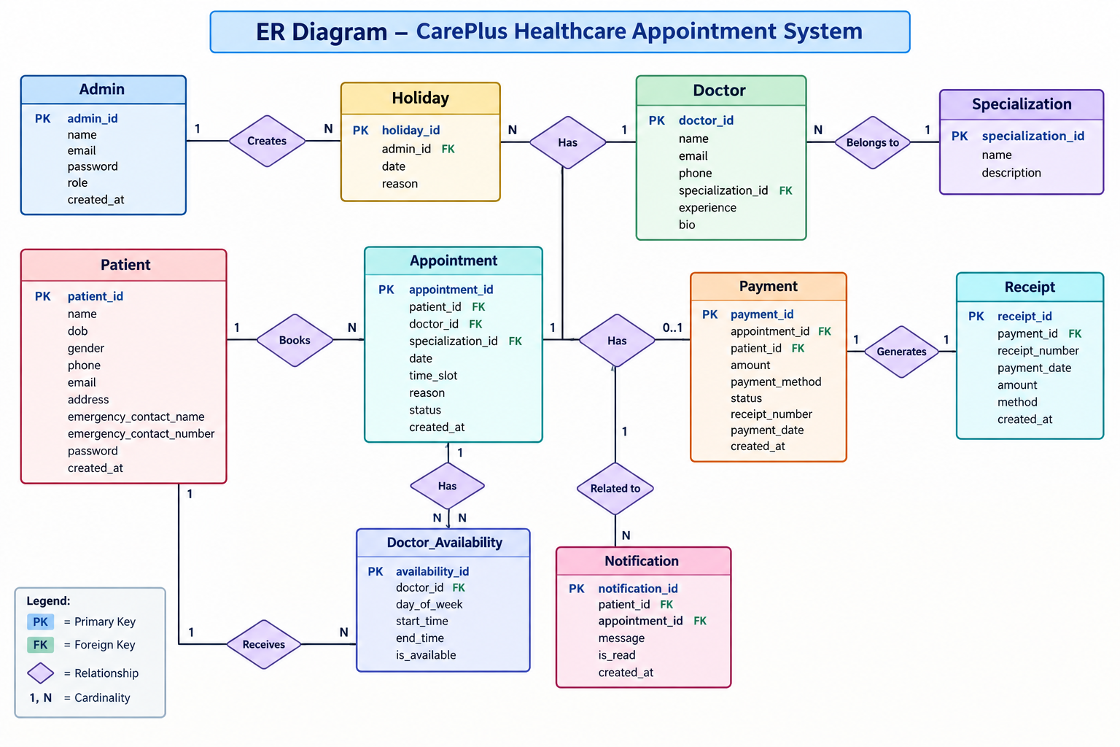
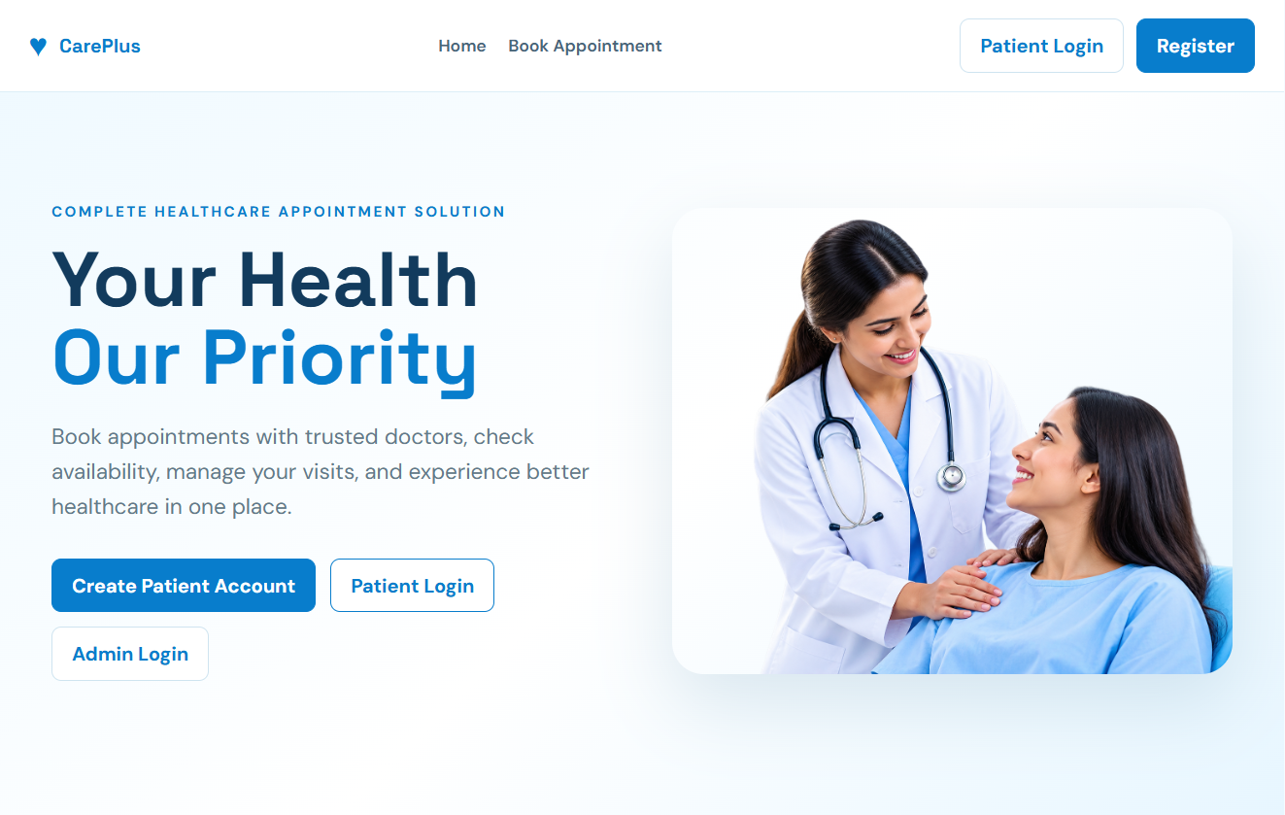
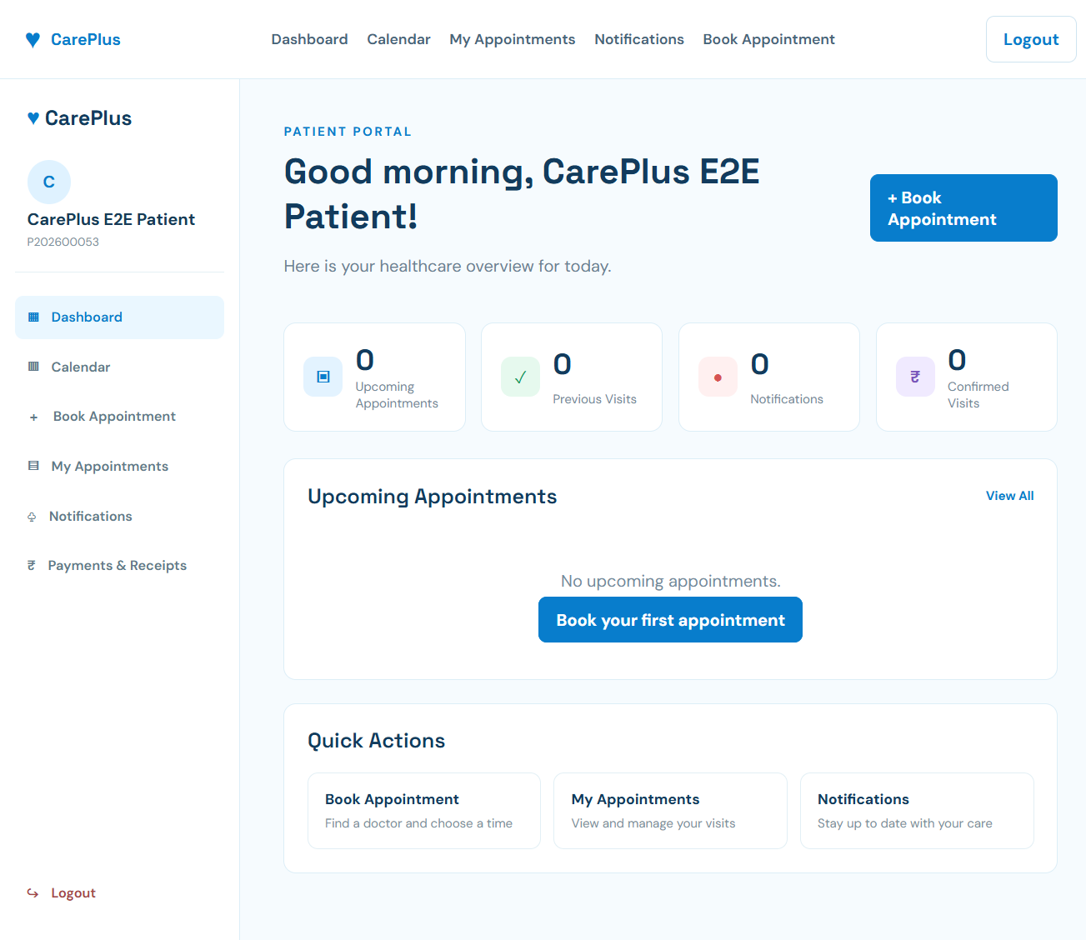
KLH Logo
“Secure and Scalable Healthcare Appointment Scheduling Through Distributed Backend Development
Team no: [8] | Section: [S 4] | Members: [Name B.Devi Charitha– Roll No. 2520030462], [Name –Monisha Raghini Chelle Roll No. 2520030537], [Name –PRASHANTHI DABBUGUNTA Roll No.2520030301 ]
Guide: Dr. Yerragudipadu Subbarayudu
Database Systems Engineering and Distributed Backend Development (25CS1302E) | KLH Bachupally Campus, CSE | PBL 2026-27
Abstract
Tools & Technologies
CarePlus is a web-based healthcare appointment scheduling system that allows patients to register, log in, search for doctors, view availability, and book appointments. The system uses a React frontend, FastAPI backend, and MySQL database with JWT-based authentication and role-based access.
The system simplifies appointment management while providing administrators with centralized control over doctors, appointments, holidays, notifications, and payments.
Frontend
React, JavaScript, HTML5, CSS3, Vite
Backend
Python, FastAPI, Uvicorn, REST APIs
Database
MySQL, SQLAlchemy, PyMySQL
Security
JWT, Passlib, bcrypt, Bearer Authentication
Development Tools
VS Code, Git/GitHub, MySQL
Problem Statement & Objectives
Problem
Traditional appointment scheduling can require manual coordination and makes it difficult to manage doctor availability, appointment slots, patient records, and booking conflicts efficiently.
Objectives
Provide an easy online appointment booking system.
Manage doctor availability and appointment slots.
Implement secure patient and administrator authentication.
Provide centralized appointment, notification, and payment management
System Architecture
Existing vs Proposed System
Feature | Existing System | Proposed System
Appointment Booking | Manual / limited online coordination | Online slot-based booking
Doctor Availability | Difficult to track | Calendar and availability management
Authentication | Basic/manual access | JWT-based authentication
Appointment Management | Separate/manual records | Centralized database
Payment | Manual processing | Demo payment + receipt
ER Diagram & Database Design
Feasibility Study
Technical
Uses commonly available technologies such as React.js, FastAPI, Python, MySQL, REST APIs, JWT, and SQLAlchemy.
Economic
Uses an open-source technology stack, reducing software and development costs.
Operational
Provides separate patient and administrator workflows with a simple web interface.
Schedule
The system can be developed and tested within the academic semester timeline.
Implementation Screenshots
[Screenshot 1]
[Screenshot 2]
Results & Testing
Conclusion
Future Scope
Patient login and appointment booking work successfully.
Doctor availability and booking validation are implemented.
Notifications and demo payments are included.
Admin can manage doctors, appointments, and payments.
CarePlus provides a simple and centralized healthcare appointment scheduling system. It enables patients to book appointments and helps administrators manage doctors, availability, appointments, notifications, and payments efficiently. The system ntegrates the React frontend, FastAPI backend, and MySQL database
Integrate a real payment gateway.
Add a separate doctor login and portal.
Enable cloud deployment and scalability.
Add advanced reminders and notifications.

